Slide 1
Stream Processing for the Practitioner: Blueprints for Common Stream Processing Use Cases with Apache Flink®
Aljoscha Krettek, Software Engineer

Slide 2
What is stream processing and why‘s it useful?

Slide 3
Use Case: “Suspicious Behaviour“ Detection
Some service or app
Dropbox, Gsuite, Box
  Sharing, accessing, and modifying data produces events that we can/want to analyse
Banking
  We monitor all transactions, know the user data

Slide 4
Use Case: “Suspicious Behaviour“ Detection
Spits out alerts when suspicious stuff is happening
  “More than 10 failed login attempts”
  ”Sharing more than 100 files within 1 Hour”
  “Impossible Travel”/”Magic carpet travel”
  “Continuously increasing withdrawal amounts”
Some service or app
“Magic” rules engine

Slide 5
Use Case: “Suspicious Behaviour“ Detection
Ok, let me just use a single machine for this!
What if my workload becomes way too high? → I’ll use a distributed batch processor. (Hadoop MapReduce, Spark, and the like)
This runs nightly? Isn’t the latency very high then? I don’t want to wait a day for my alerts 😳
I need alerts in real time → Apache Flink® is a real-time, distributed, stateful, and fault-tolerant stream processor

Slide 6
Detour: Thinking in Flows
sink
user operations/user code
source
Apply Rules
Send Alerts
Data Ingress
Filter
Transform
State
Persist to database
flow of data / events

Slide 7
Why flows and operations?
Operations can be composed and are reusable
Operations can be developed by different teams because of separation of concerns
Makes it easy to think about the flow of data
Allows a system (Flink) to take these operations and execute them on different machines
A system can execute the same operation multiple times on several machines to deal with high workloads

Slide 8

Apache Flink® distributed stateful stream processor
Note how we have the “expensive” stateful operation twice
Machine 1
Machine 2
Flink has nice APIs for writing these!

Slide 9
Apache Flink® distributed stateful stream processor
Questions that a good stream processing systems needs to have answers for:
  What happens when machines fail or when user operations fail?
  What happens if I need to move my stateful operations/flows/jobs?
  What happens if I need to change the schema of the state that operations keep?
  How can I update framework code while keeping my program state?
  Same for user code?

Slide 10
Common stream processing blueprints

Slide 11
Blueprint: Aggregation of timestamped data
Use cases
  Give me the number of tweet impressions per tweet for every hour/day/…
  Calculate the average temperature over 10 minute intervals for each sensor in my warehouse
  Aggregate user interaction data for my website to display on my internal dashboards

Slide 12
Blueprint: Aggregation of timestamped data
source
windowed
aggregation
sink
state: contents of all the in-flight windows

Slide 13
Blueprint: Aggregation of timestamped data
Some things to look out for.
Do I want to window by event-time or processing time?
If using event-time, how do I know when my window is “done”?
What happens if data arrives out of order with respect to their timestamp?
If using event-time, when is data considered late?
What should happen with late data?

Slide 14
Blueprint: Aggregation of timestamped data
Flink features to look at.
Windowing API
Timestamp assigners/watermark extractors for defining event-time and defining “readiness”
Allowed lateness for defining when data is late
Side output of late data as a special flow path

Slide 15
Blueprint: Aggregation of timestamped data
allowed lateness: 10 min
kinesis
windowed
aggregation
write to Elastic
extract timestamps/watermarks
alert real humans
side output
late data

Slide 16
Blueprint: Enriching data with “side input”
Use cases
  Enrich user events with known user data
  Add geolocation information to geotagged events

Slide 17
Blueprint: Enriching data with “side input”
filter
enrich

Slide 18
Blueprint: Enriching data with “side input”
synchronous access to external data store for every element
Naïve approach
filter
enrich

Slide 19
Blueprint: Enriching data with “side input”
asynchronous access to external data store for every element
Slightly better approach
filter
enrich
Notes:
Explain how Flink has API for starting multiple I/O requests, keeping track of order and making sure that things are fault-tolerant.

Slide 20
Blueprint: Enriching data with “side input”
changelog input
keep the enrichment data in Flink state itself
filter
enrich
“Next-level” approach
Notes:
Explain how Flink has API for starting multiple I/O requests, keeping track of order and making sure that things are fault-tolerant.

Slide 21
Blueprint: Enriching data with “side input”
Flink features to look at.
Regular user functions/operations
Async I/O operation for more efficient data store accesses
Two-input operations and stateful operations

Slide 22
Blueprint: Dynamic processing
Use cases
  Update of processing rules via DSL, think dynamic fraud-detection rules/policies
  Live-update of machine learning models

Slide 23
Blueprint: Dynamic processing
rules
input
broadcast
stream
pre-
processing
dynamic processing
input
broadcast state

Slide 24
Blueprint: Dynamic processing
Flink features to look at.
ProcessFunction
Broadcast streams and broadcast state

Slide 25
Closing

Slide 26
Learnings
When you want immediate results you probably need a stream processor
Getting state, fault-tolerance, and event-time right is tough, check what your stream processor has as answers for the though questions
Start thinking in terms of data flows and reusable operations that you can mix and match
Flink has your use cases covered

Slide 27


Slide 28
Thank you!
aljoscha@apache.org
@dataArtisans
@ApacheFlink
We are hiring!
data-artisans.com/careers
Notes:
(Keep this slide up during the Q&A part of your talk. Having this up in the final 5-10 minutes of the session gives the audience something useful to look at.)

Slide 29


About Data Artisans
Original creators of
Apache Flink®
Open Source Apache Flink
+ dA Application Manager
Notes:
• data Artisans was founded by the original creators of Apache Flink
• We provide dA Platform, a complete stream processing infrastructure with open-source Apache Flink

Slide 30
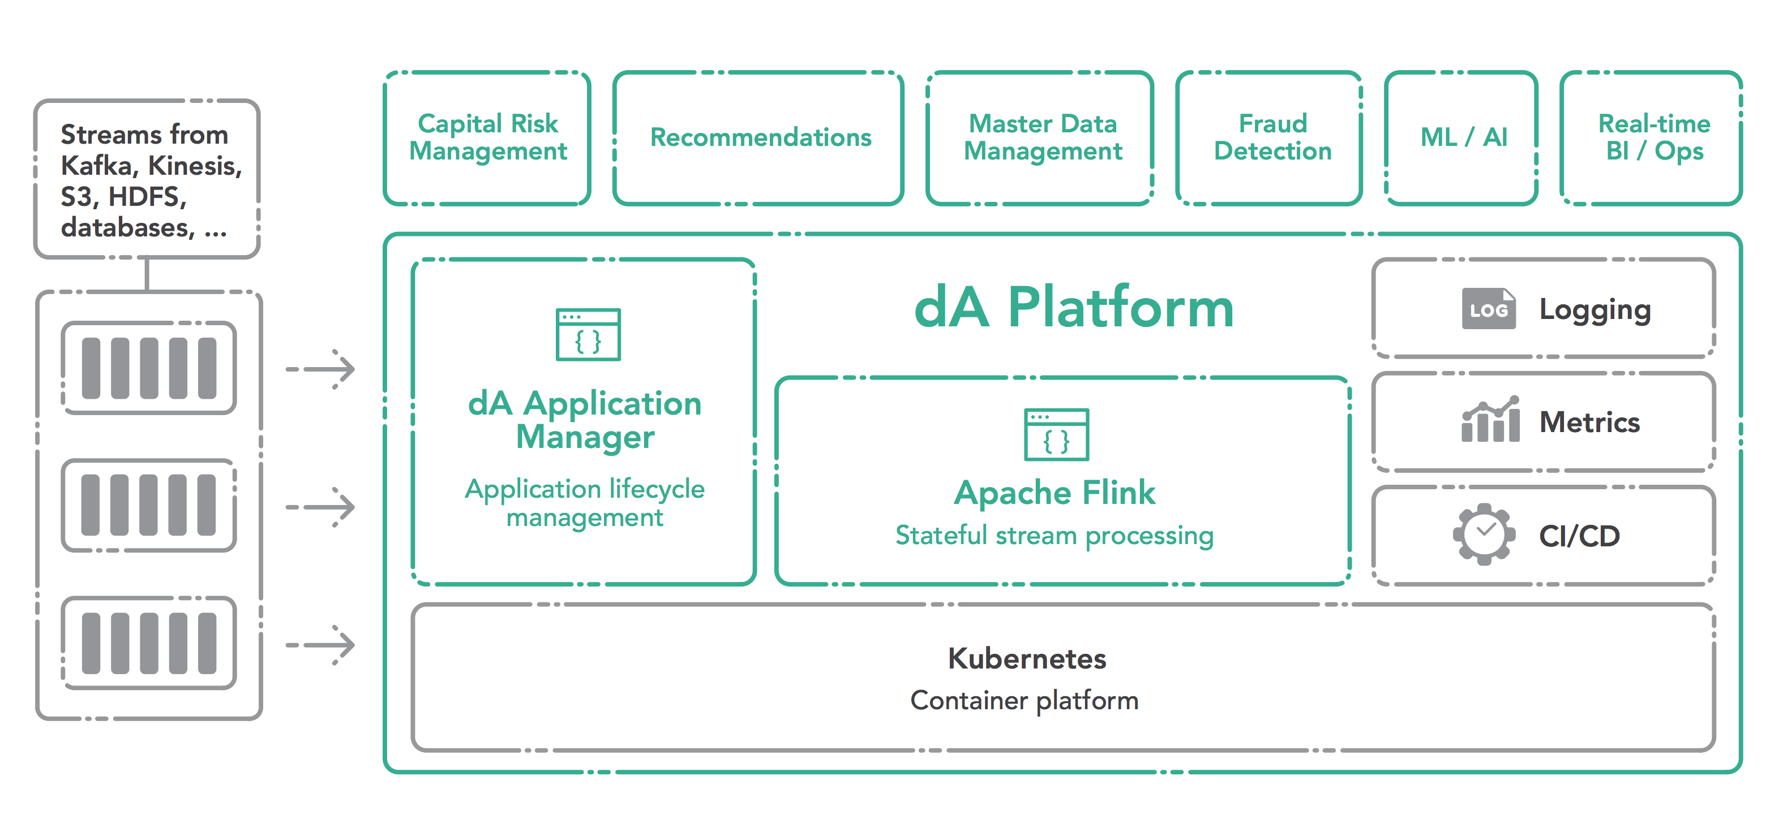
dA platform
data-artisans.com/download
Notes:
• Also included is the Application Manager, which turns dA Platform into a self-service platform for stateful stream processing applications.
• dA Platform is generally available, and you can download a free trial today!

Slide 31






























Powered by Apache Flink
Notes:
• These companies are among many users of Apache Flink, and during this conference you’ll meet folks from some of these companies as well as others using Flink.
• If your company would like to be represented on the “Powered by Apache Flink” page, email me.

Slide 32

Download the free book
info.data-artisans.com/book
Notes:
(Optional slide – may not be appropriate for advanced audience. Helps us capture leads.)

